Slide 1



Making an Impact with Data:
Uncovering DePaul's Global Student Pipeline
Presented By: Impact Makers | Team 5
(Rahul,Souvik,Mayuri,Funke, Alade)
Tools Used: Power BI, Excel, Python

Slide 2



Data-Driven Analysis of International Student Admissions at DePaul University
This project focuses on analyzing international student admission data from DePaul University to understand application trends, student demographics, and program preferences. Using data analysis and an interactive dashboard, the study provides insights to improve recruitment strategies and support data-driven decision-making.

Slide 3


Key Skills Required
Data Cleaning & Preparation
Data Analysis & EDA
Technical Skills
Data Visualization
Analytical Thinking

Slide 4

Understanding Data
Unstructured Data
The DePaul University dataset was initially in an unstructured and inconsistent form because it was merged from multiple systems. This resulted in duplicated columns (like University, University-2, University-3), mixed formats, and scattered information such as student profiles and interaction logs, making it difficult to analyze directly.
Structured Data
To make it structured, the data was cleaned and organized by removing duplicate fields, handling missing values, and standardizing formats. Relevant information was then arranged into clear columns like country, program, intake, and admission status, converting the dataset into a consistent tabular form suitable for analysis and dashboard creation.

Slide 5
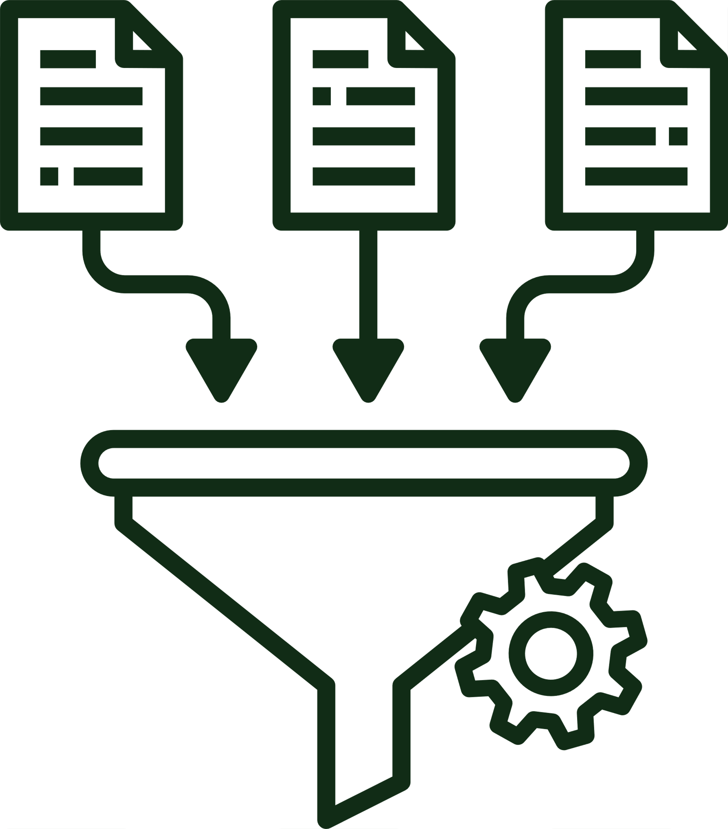



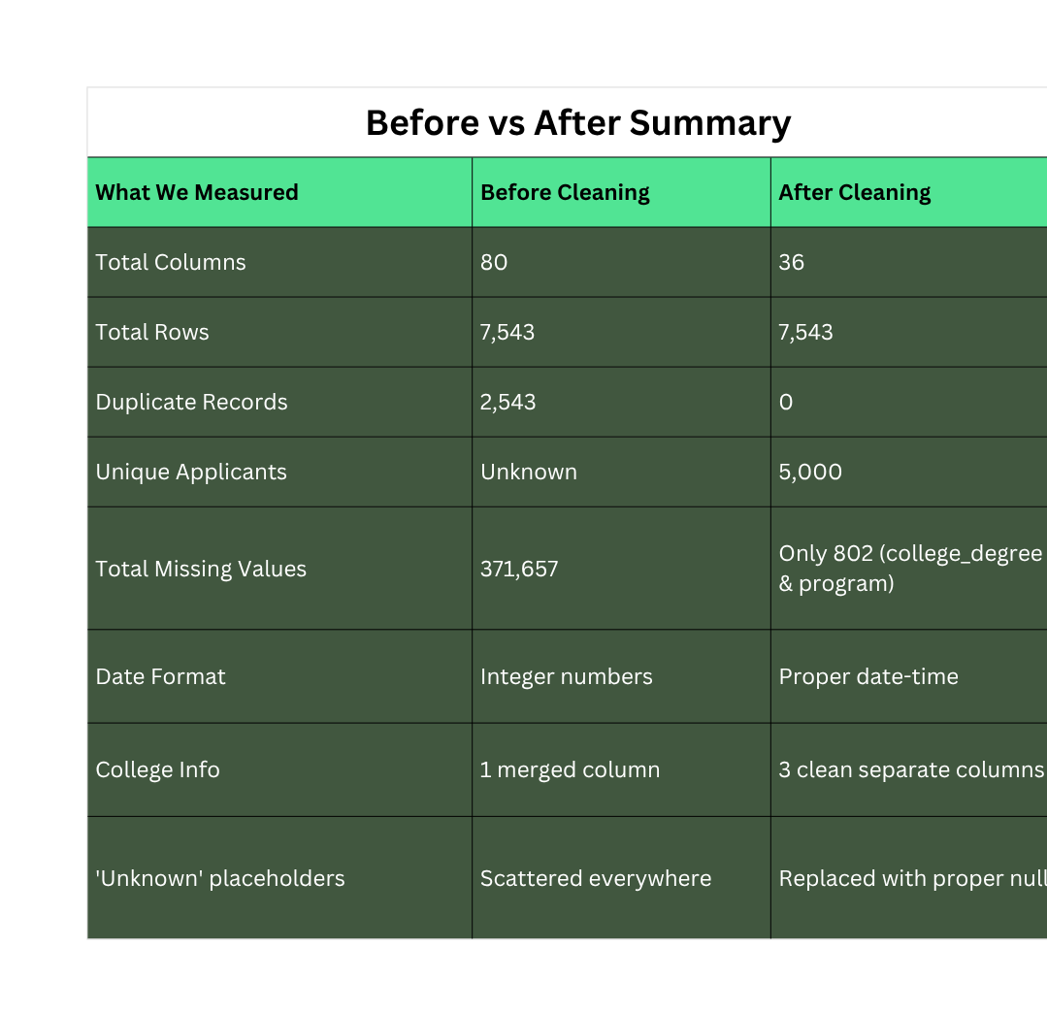
Data Cleaning & Preprocessing

Slide 6
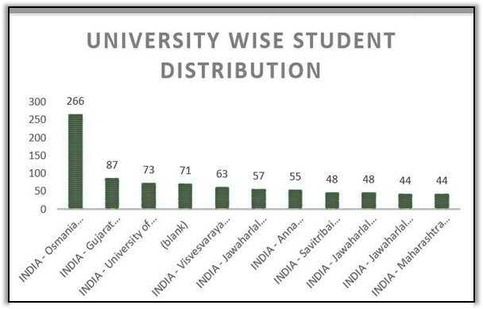
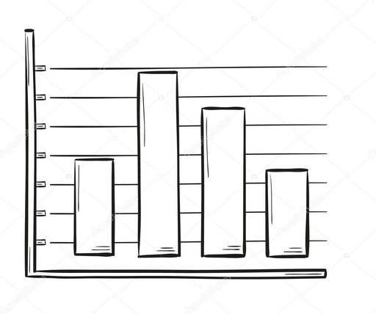
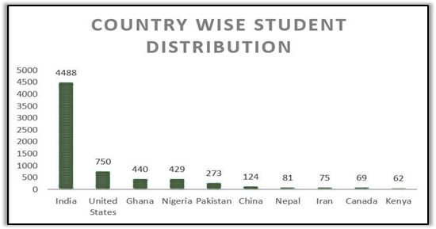

Exploratory Data Analysis (EDA)

Slide 7

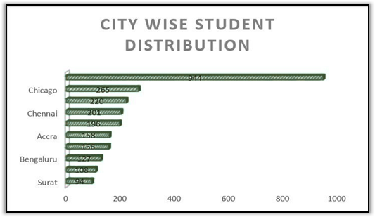

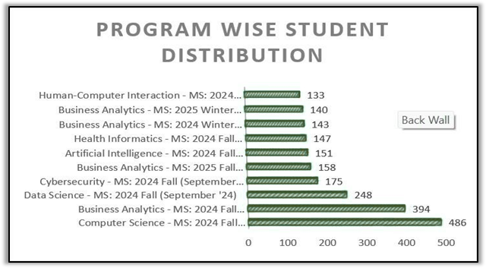

WEEK 1 TASK

Slide 8
Statistical Analysis Techniques
S.No. | Technique | What We Did | What We Found | Measure Used
1 | Frequency Distribution | Counted how many times each value appeared in columns like Country, Program, and University | India appeared 4,488 times — the single largest group in the entire dataset | Count per category
2 | Descriptive Statistics | Calculated mean, median, minimum, and maximum values for all numerical columns | Reference_ID had a mean of ~473M — confirming it was just a system ID with no real value | Mean · Median · Min · Max
3 | Missing Value Analysis | Calculated the number and percentage of empty or null entries across all 80 columns | Remark_2 was 99% empty · 30+ columns had zero data · 371,657 total missing values | Null count · % missing
4 | Duplicate Detection | Counted how many times each Reference_ID appeared to find repeated student records | 2,543 duplicate rows found · one ID appeared 48 times · only 5,000 truly unique students | Duplicate row count
5 | Percentage Calculation | Converted raw counts into percentages to make patterns easier to understand and present | India = 59% · Computer Science = most popular · Fall = highest intake period | Proportion · Share %
6 | Unique Value Count | Checked how many distinct values existed in each column to understand data diversity | Country had 95 unique values · Program had 19 · helped spot inconsistent category labels | Cardinality · Distinct count
7 | Distribution Check | Looked at how values were spread across categories using bar charts and frequency tables | Data was heavily skewed — a few countries and programs dominated while most had low numbers | Spread · Skewness
8 | Data Profiling | Examined each column's data type, sample values, and structure to spot formatting problems | Dates stored as integers · merged columns · "Unknown" used as filler instead of null | Data type · Format check

Slide 9


Dashboard & Reporting

Slide 10

Recommendations & Action Plan
Recommendation
Action Plan
Expected Impact
Expand outreach to emerging markets like Nigeria, Ghana, Brazil, and Vietnam through digital campaigns and local education partners
Build new relationships with more feeder schools beyond the current few
Focus maximum recruitment energy and staffing around the Fall intake cycle
Run dedicated marketing campaigns for non-STEM programs to balance enrollment
Use the Power BI dashboard to track trends, spot gaps, and personalize communication with every prospective student
Wider and more stable applicant pipeline — no longer dependent on one region or two programs
Faster and smoother processing during the Fall rush
Healthier enrollment numbers across all departments
More meaningful and personalized engagement with students worldwide
A smarter, data-driven recruitment system that helps DePaul grow its international student community in a sustainable and strategic way
Stop over-relying on India and STEM programs
Build a more diverse, balanced, and globally spread student recruitment strategy
Back every decision with data from the dashboard

Slide 11
Conclusion
What We Did:
Successfully transformed messy, unstructured admission data into a clean and structured format
Analyzed the data to uncover meaningful and actionable insights
What We Found:
Identified key trends in student demographics, program preferences, and application patterns
Strong demand for STEM programs — Science, Technology, Engineering, and Mathematics
Fall intake consistently had the highest number of applications
What We Built:
Created an interactive dashboard that visualized all insights clearly
Made data-driven decision-making easier for the university team
What We Gained:
Enhanced our skills in data cleaning, analysis, and visualization
Grew stronger as a team through collaboration and problem-solving
Delivered valuable recommendations to help improve DePaul's recruitment strategies

Slide 12

Thank You
WE APPRECIATE YOUR VALUABLE TIME.
Dashboard Link

